Slide 1
Anemia detection using ensemble learning

Slide 2
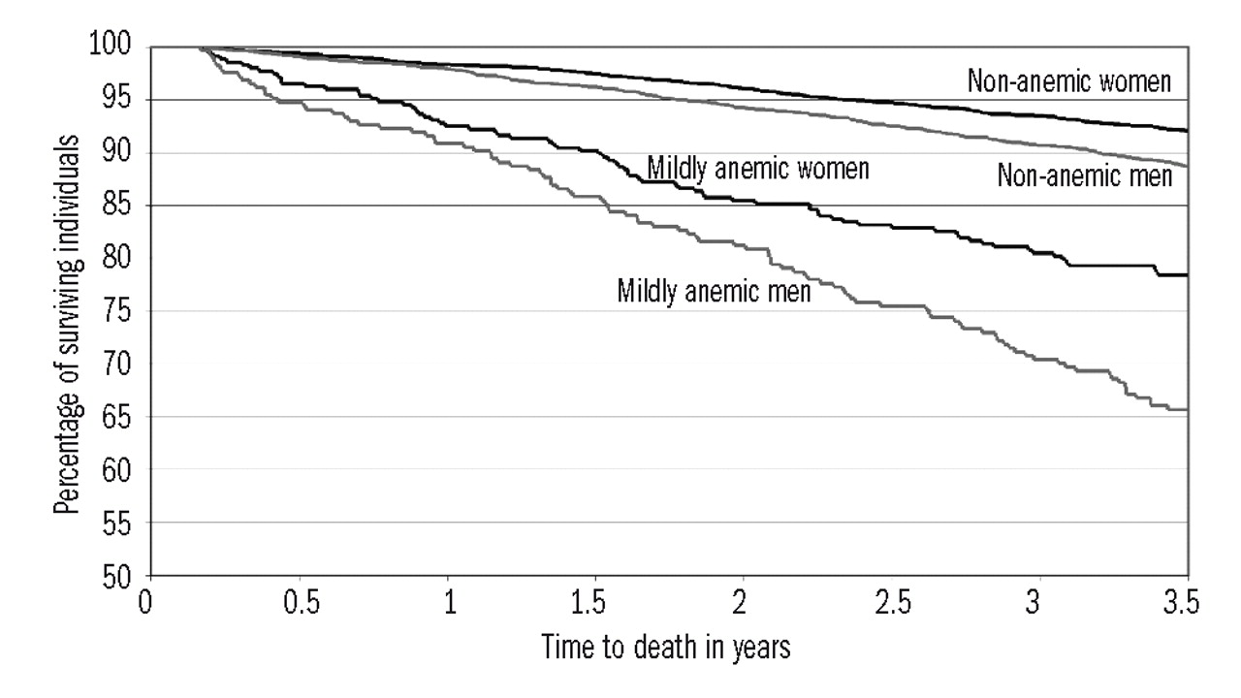
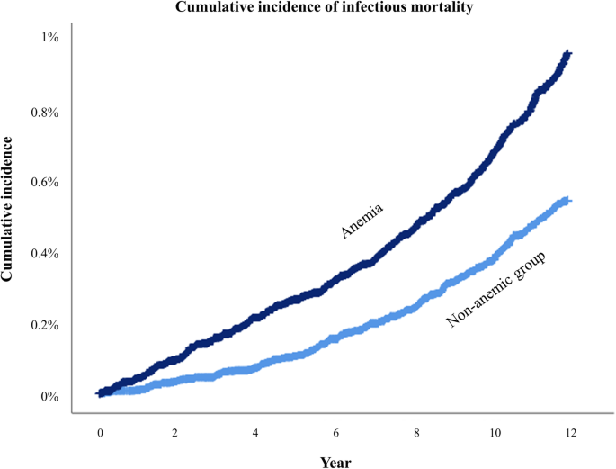
Statistics related to Anemia.

Slide 3
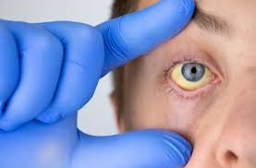
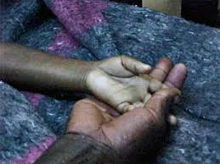
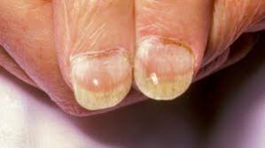
Major Symptoms of Anemia.
Eye conjunctivitis
Pale Palm
Finger nail deformities

Slide 4
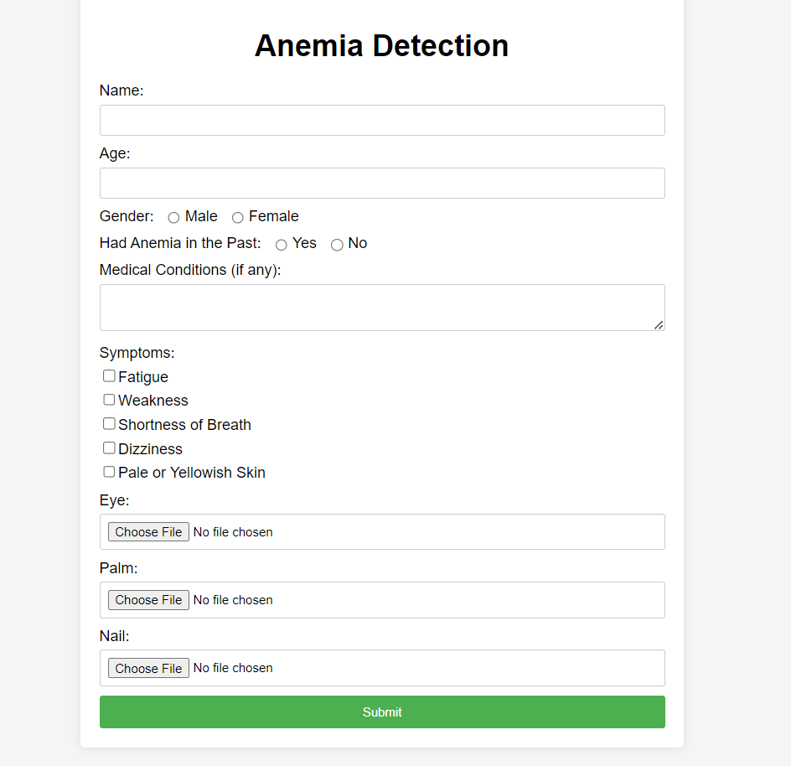
Inputs taken from user.
Images of :
Eye
Palm
Finger nails
Personal information about age, gender, history of anemia, Symptoms and any medical conditions.

Slide 5
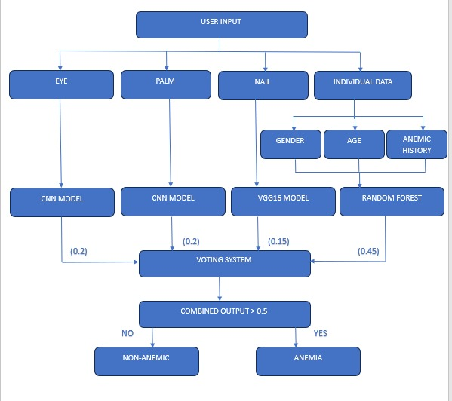
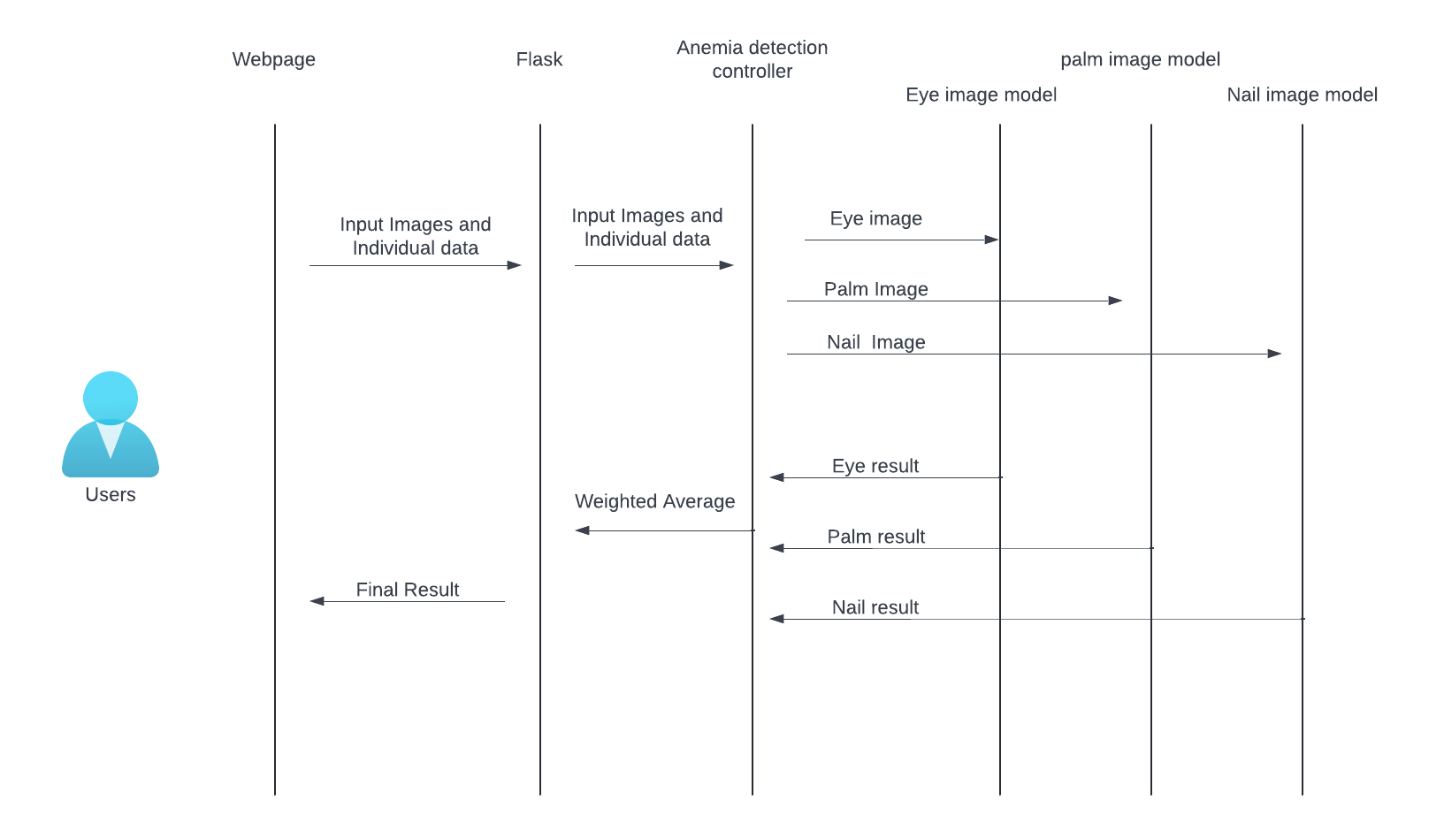
Proposed System.

Slide 6
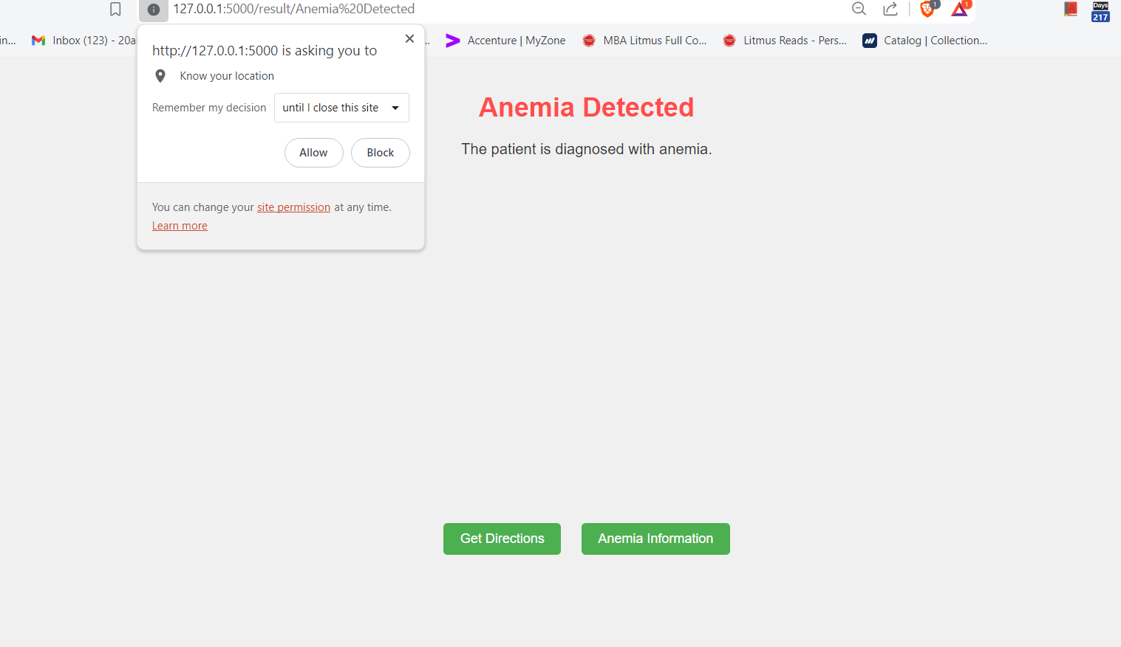
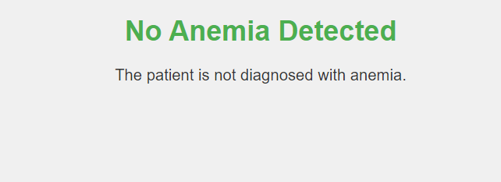
Results.

Slide 7
Machine learning concepts used.
Ensemble learning.
Convolutional Neural Network (for the Eye Image model).
Image Classification using VGG16 framework(for the fingernail Image model).

Slide 8
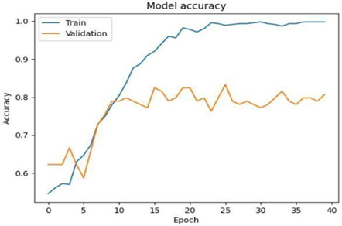

Eye Image Model.
Convolutional Neural Network
Convolutional Layers: 4 layers (extracting features)
Max Pooling Layers: 4 layers (reducing dimensionality)
Dense Layers: 2 layers (classification)
Output Layer: 1 layer (predicting probability)

Slide 9
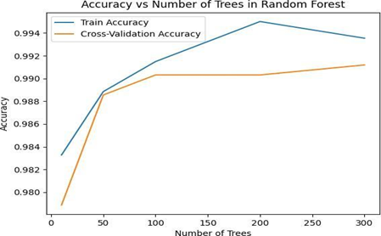
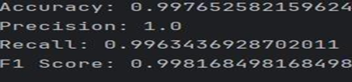
Palm Image Model.

Slide 10
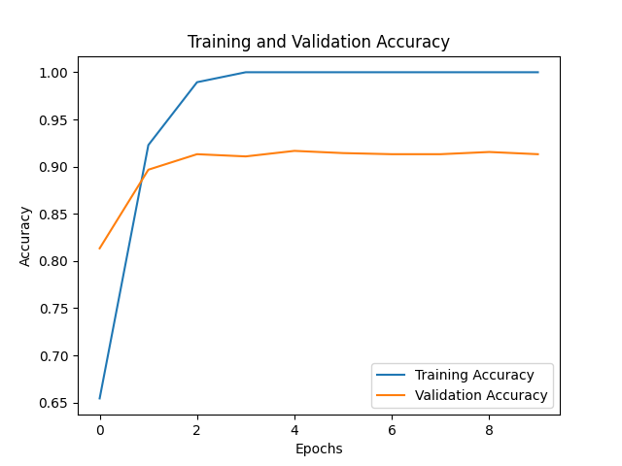
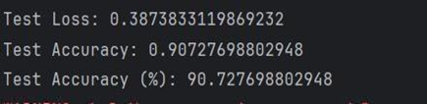
Fingernail Image Model.
Transfer Learning Base: VGG16.
Optimiser : Adam.
Epochs: (10).
Batch Size: (32).

Slide 11
Data used.
Eye images : 800.
Palm images : 2500.
Fingernail images : 2500.
Personal information : 150 sets.

Slide 12
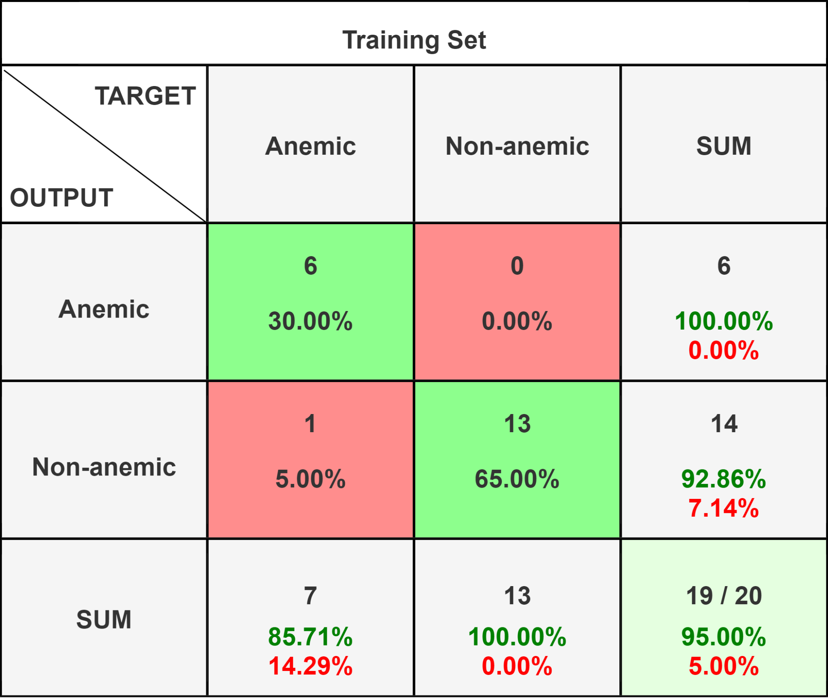
Testing.
We have tested the model in a private clinic on 20 patients.

Slide 13
Advantages.
Future Endeavors
Better accuracy when multiple factors are taken into consideration.
Faster, easier and affordable access without the need of medical infrastructure and medical expertise.
Efficient screening method which will reduce undetected progression of the disease.
Increase the efficiency of the eye image model.
Develop the mobile application
Test in more clinics and hospitals.

Slide 14
Conclusion.
Our project is dedicated to develop a machine learning model that leverage patient family information and body images to predict anemia.
The primary aim is to offer a non-invasive, accessible, and early detection method for anemia, a global health concern affecting millions.
The use of DNN takes multiple factors into consideration so the result and the efficiency of the model is better than any other model that is developed or the traditional method.

Slide 15
Thank you

